Slide 1

The Attack on Access to Justice
A talk by David Sorensen, Partner
Morrish Solicitors LLP
To The Institute of Employment Rights, 8 February 2017
Notes:
1

Slide 2

Access to Justice (1)
What is it?
Fundamental rights, freedoms, a fair trial and the rule of law are vital checks and balances for a civilised society
These are meaningless (paper rights only) without a practical means of:
Understanding the law &
Enforcing it
Legal advice and representation seems boring and unimportant until you’re in trouble or in need.
Notes:
2

Slide 3
Access to Justice (2)
Magna Carta:
“We will sell no man, we will not deny or defer to any man either Justice or Right”.
1945 Labour Government introduced legal aid as the “fourth pillar of the welfare state”.
Notes:
3

Slide 4
Access to Justice (3)
Winston Churchill:
Courts should “administer open and well-established laws which are associated ….with the broad principles of decency and justice” with “fair play for poor as well as rich, for private persons as well as Government officials”.
“Civilisation means that the civilians and ordinary folk have rights and liberties which they can effectively enforce against hierarchies and bureaucracies”.
Notes:
4

Slide 5
Access to Justice (4)
Shami Chakrabarti:
“There is no longer a level playing field. When it comes to legal advice, the rich can pay, the not-so rich will struggle to find the means and under the new reforms, even the poorest may be shut out”
Notes:
5

Slide 6
The attack
What harms access to justice?
Removal of protections and rights
Removal or reduction in oversight by regulators
Expensive Court Fees
Closure of Courts
Lack of lawyers and legal advice
Risk of losing and adverse legal costs
Complexity of proceedings a deterrent
Legal aid cuts
Notes:
6

Slide 7
The battlefield
Impact where?
Criminal courts
Traditional civil courts
Tribunals – employment, immigration etc.
Regulatory bodies e.g. HSE
Notes:
7

Slide 8
Scope?
Main focus here is on England, Wales and Scotland.
Fair to say Scottish cuts to legal aid, for example, have been less severe.
Also Northern Ireland has suffered less.
Notes:
8

Slide 9
Removal of protections and rights
Personal Injury – redefinition of liability for workplace accidents making it easier for employers to reduce safety and avoid blame.
Car crashes – limiting or stopping compensation for injuries e.g. whiplash, broken wrists etc.
Extending unfair dismissal qualifying period to two years from one year.
Removing lay members in ETs in most claims that don’t involve discrimination.
Removal of witness expenses in ETs and other Tribunals.
Under-used powers – ET financial penalty on employer power used 18 times and recouped £18k in two years (only 12 of 18 paid in full!)
Notes:
9

Slide 10
Cuts to regulators
HSE – a 46% cut to funding since 2010
50% fall in workplace HSE inspections
Equality and Human Rights Commission – a 75% cut in funding since 2010
Severe cuts in advice and assistance
Notes:
10

Slide 11
Expensive court fees
“our justice system has become unaffordable to most” – current Lord Chief Justice!
60% rise in divorce court fees since 2013 - number of unrepresented parties has doubled.
Other court fees have risen as much as 600%.
Very serious accident – court issue fee now £10,000!
ET fees – up to £1,200 for those who have just been dismissed…..
For those who have been made redundant by an insolvent employer (City Link, Austin Reed etc.) the combined ET fees are high e.g. for 11 Claimants it is £4,800 (and unlikely to be reimbursed as employer insolvent….)
Notes:
11

Slide 12
Closure of courts
Between 2010 and 2015, 146 courts closed. Further 86 earmarked to be closed.
Many courts and tribunals brought into same premises – civil Claimants sharing space with criminal defendants.
Harm? Increases travel time and cost to get to court – instead of 30 minutes can now be a 5-6 hour round trip.
Deters individuals going to or engaging with court processes.
No adequate online replacement despite lots of talk! Previous IT projects poor quality.
Notes:
12

Slide 13
Lack of lawyers and advice
Law centres for free advice – 3,226 in 2005. 1,462 in 2013 – a 55% cut. For every £1 spent by a law centre, return estimated to be £10.
Certain areas have very few providers of legally aided representation owing to reduction in number of legal aid contracts. Some have none e.g. no law firms at all in Suffolk and Shropshire for legally aided housing advice.
2,500 child immigration and human trafficking cases and 6,000 vulnerable children each year in the family courts without legal support in court.
Rise of litigants in person and clogged courts. Denial of justice and right to fair trial.
Notes:
13

Slide 14
Cost of lawyers
Current Government personal injury proposals – will raise small claims limit to £5,000 meaning that those with ‘moderate’ injuries will no longer get their legal fees paid by the insurer if they win. Research suggests that 70% of Claimants would no longer pursue their claim in such circumstances. Goodbye lawyers (35,000?) ….expected to save UK insurers £1 billion per year (savings passed onto the driver….?).
Without this and adequate legal aid, lawyers’ fees remain unaffordable to many and certainly those on low or even average incomes.
Notes:
14

Slide 15
Risk of losing and adverse legal costs
Costs awards are now more and more encouraged in ETs.
Rules of personal injury litigation means that the risk of not having your own legal fees paid has increased as has the risk of having adverse legal fees awarded against you.
Notes:
15

Slide 16
Complexity of proceedings
The ‘Help with Fees’ remission guidance to claim a discount or full removal of a court fee for those on low incomes is 19 pages long!
Even in the ETs, there has been a move to increasing complexity – more preliminary hearings, more early assessments, increased reliance on drafted documents, burdensome early case management steps, Presidential guidance etc. – can act as a deterrent to both parties but particularly Claimants who are more likely to be unrepresented and intimidated by the complexity.
Notes:
16

Slide 17
Legal aid cuts
Civil claims – in the 1980s, 80% of households eligible for legal aid. By 2008 that was 29%. In 2017 it is predicted to be approximately 15%.
Removal of legal aid for nearly all debt, education, housing, welfare and many immigration cases.
For every £1 spent on legal aid for benefits advice, the state saved nearly £9.
Nearly 50% fall in legally aided cases within a year of the changes – that’s 500,000 individuals losing the right to legal aid.
99% fall in legally aided welfare benefits case (88,000 to 145).
Notes:
17

Slide 18
Impact?
Rise in homelessness e.g. since 2010, 53% rise in forcible evictions of tenants.
Rise in suicides.
Rise in children in dangerous circumstances or taken into care e.g. 60% fall in family cases in the courts.
Reduction in claims for domestic abuse.
Less representation in the criminal courts – more miscarriages of justice and risk of abuse of powers by law enforcement authorities.
Notes:
18

Slide 19
Fight back?
Various reviews and reports underway.
HoC – committees.
Labour Party reviews.
Brexit consequences – further erosion of protections as a result? Human Rights Act 1998, discrimination laws etc.?
Government’s (belated) consultation on the ‘Review of the introduction of fees in the ETs’ published 31.01.17.
Notes:
19

Slide 20
Fight back?
Sir Oliver Heald, Minister of State for Justice: “There is no doubt that fees, alongside the introduction of the early conciliation service, have brought about a dramatic change in the way that people now seek to resolve workplace disputes. That is a positive outcome, and while it is clear that many people have chosen not to bring claims to the Employment Tribunals, there is nothing to suggest they have been prevented from doing so”.
“there is also some evidence that some people who have been unable to resolve their disputes through conciliation have been discouraged from bringing a formal ET claim because of the requirement to pay a fee”.
So “discouraged” but not “prevented”? Eh?
Notes:
20

Slide 21
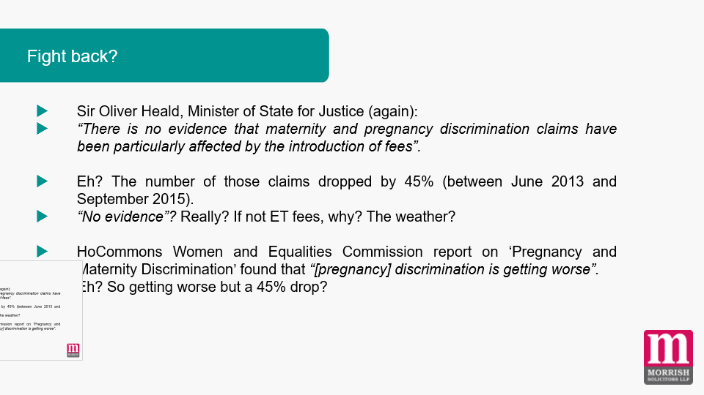
Fight back?
Sir Oliver Heald, Minister of State for Justice (again):
“There is no evidence that maternity and pregnancy discrimination claims have been particularly affected by the introduction of fees”.
Eh? The number of those claims dropped by 45% (between June 2013 and September 2015).
“No evidence”? Really? If not ET fees, why? The weather?
HoCommons Women and Equalities Commission report on ‘Pregnancy and Maternity Discrimination’ found that “[pregnancy] discrimination is getting worse”.
Eh? So getting worse but a 45% drop?
Notes:
21

Slide 22
Fight back?
Proposals to widen ET fee remission
& remove ET fees for 3 limited claims to the National Insurance Fund
Consultation closes 14 March 2017
Notes:
22

Slide 23
Any Questions ?
Notes:
23

Slide 24


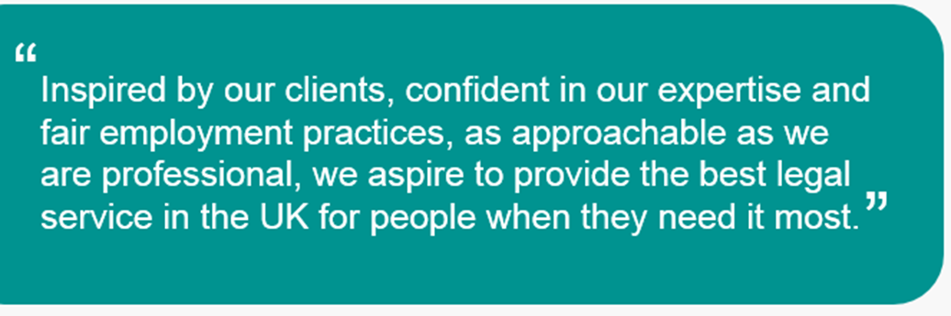

Notes:
24

